Slide 1
Convolutional Neural Networks

Slide 2
CNN
A Convolutional Neural Network (ConvNet/CNN) is a Deep Learning algorithm which can take in an input image, assign importance (learnable weights and biases) to various aspects/objects in the image and be able to differentiate one from the other.
The pre-processing required in a ConvNet is much lower as compared to other classification algorithms.
convolutional neural networks (ConvNets or CNNs) are more often utilized for classification and computer vision tasks.
The role of the ConvNet is to reduce the images into a form which is easier to process, without losing features which are critical for getting a good prediction.

Slide 3
CNN
Convolutional Neural Networks are very similar to ordinary Neural Networks : they are made up of neurons that have learnable weights and biases.
Each neuron receives some inputs, performs a dot product and optionally follows it with a non-linearity.
ConvNet architectures make the explicit assumption that the inputs are images, which allows us to encode certain properties into the architecture.

Slide 4
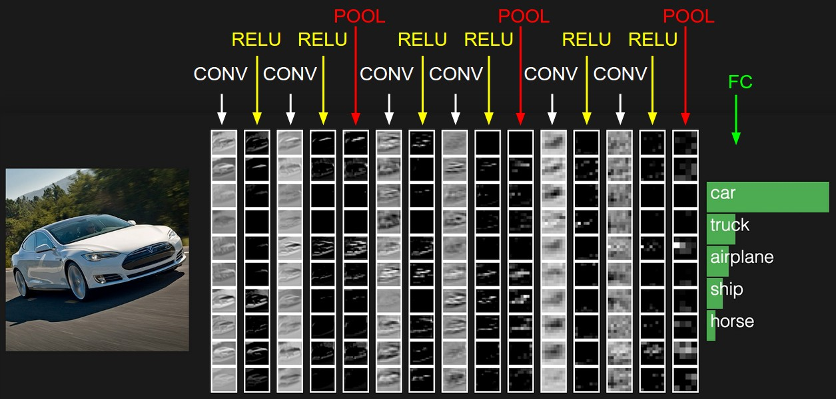
Example

Slide 5
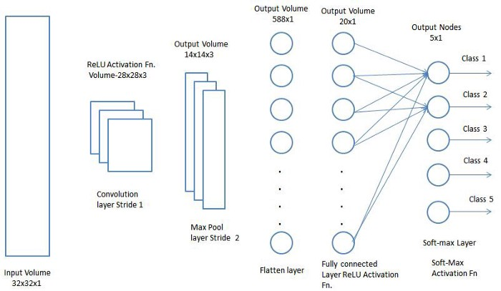

Slide 6

CNN

Slide 7
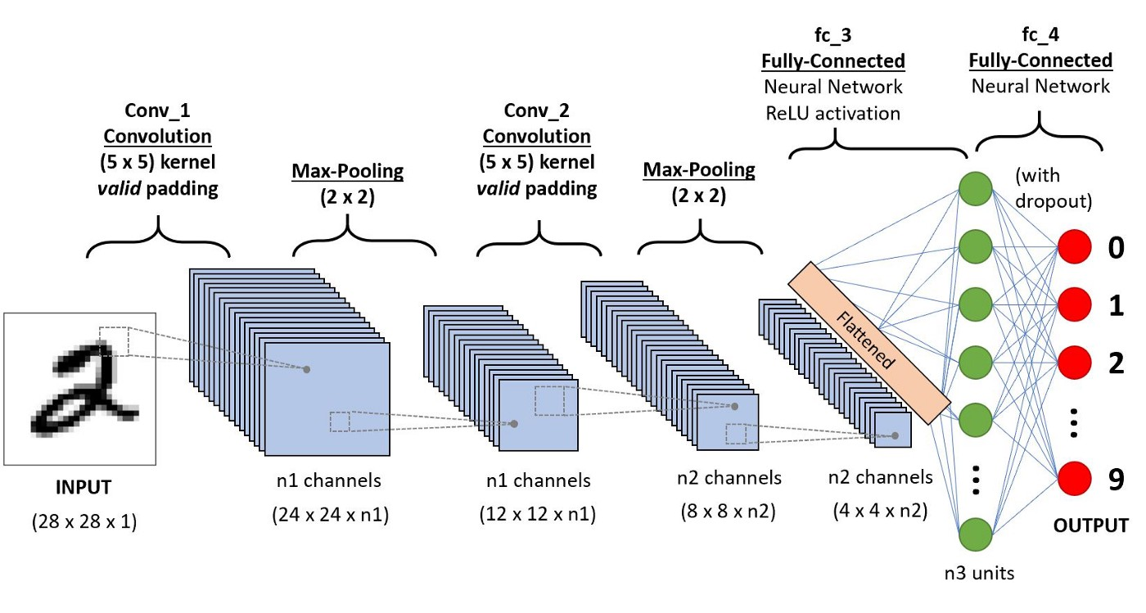
CNN

Slide 8
CNN
Convolutional neural networks are distinguished from other neural networks by their superior performance with image, speech, or audio signal inputs. They have three main types of layers, which are:
Convolutional layer
Pooling layer
Fully-connected (FC) layer
The convolutional layer is the first layer of a convolutional network. While convolutional layers can be followed by additional convolutional layers or pooling layers, the fully-connected layer is the final layer.

Slide 9
Layers used to build ConvNets : Example considering input image 32*32*3
INPUT [32x32x3] will hold the raw pixel values of the image, in this case an image of width 32, height 32, and with three color channels R,G,B.
CONV layer will compute the output of neurons that are connected to local regions in the input, each computing a dot product between their weights and a small region they are connected to in the input volume. This may result in volume such as [32x32x12] if we decided to use 12 filters.
RELU layer will apply an elementwise activation function, such as the max(0,x) the thresholding at zero. This leaves the size of the volume unchanged ([32x32x12]).
The Pooling layer is responsible for reducing the spatial size of the Convolved Feature.
FC (i.e. fully-connected) layer will compute the class scores, resulting in volume of size [1x1x10]…….(where each of the 10 numbers correspond to a class score)

Slide 10
Convolutional Layer
The convolutional layer is the core building block of a CNN, and it is where the majority of computation occurs.
It requires a few components, which are input data, a filter, and a feature map.
Let’s assume that the input will be a color image, which is made up of a matrix of pixels in 3D.
This means that the input will have three dimensions—a height, width, and depth—which correspond to RGB in an image.

Slide 11
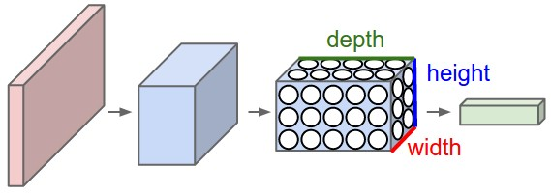
Image representation in 3D form

Slide 12
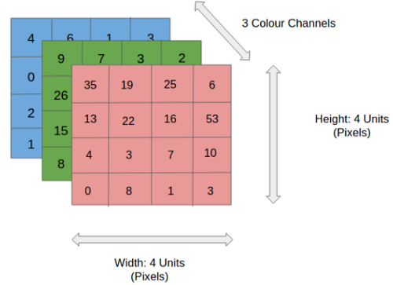
Convolutional Layer

Slide 13
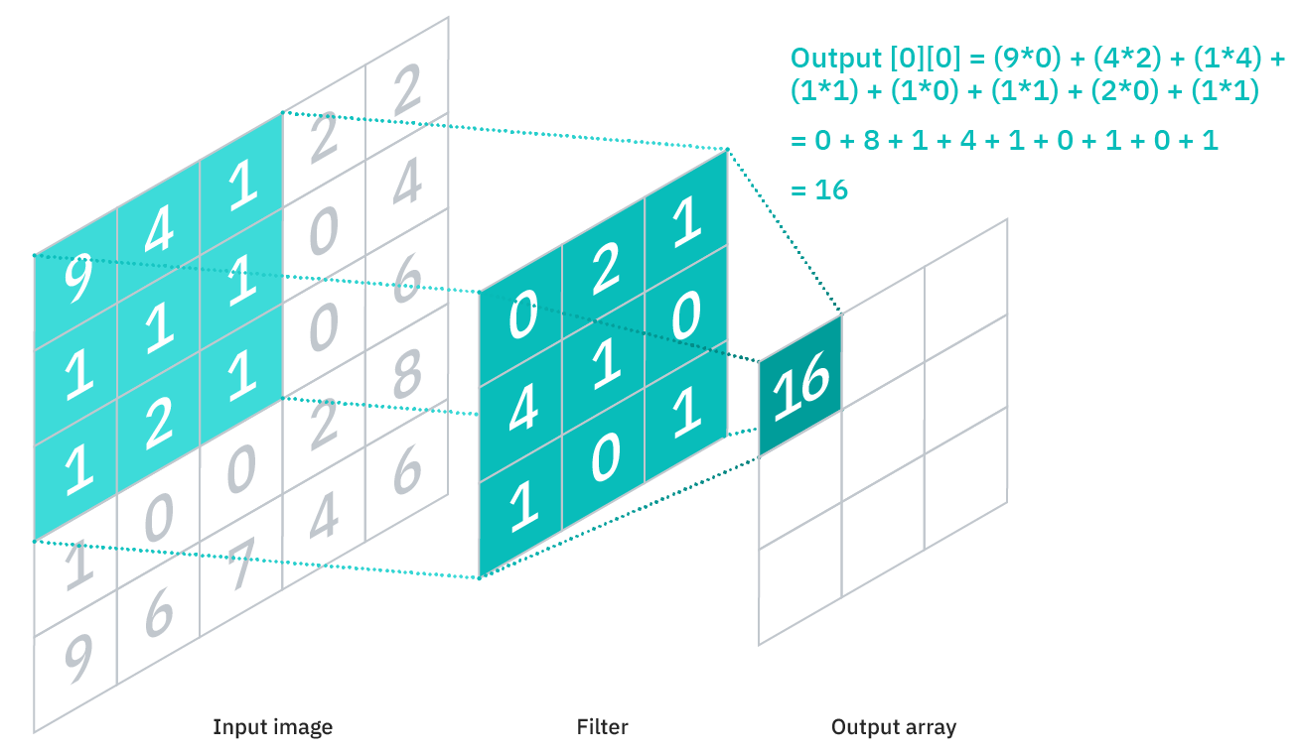
Convolutional Layer

Slide 14
Stride-2

Slide 15
Convolution Layer — The Kernel

Slide 16
CONVOLUTIONAL OPERATION

Slide 17
Convolutional Layer
We also have a feature detector, also known as a kernel or a filter, which will move across the receptive fields of the image, checking if the feature is present. This process is known as a convolution.
The feature detector is a two-dimensional (2-D) array of weights, which represents part of the image.
While they can vary in size, the filter size is typically a 3x3 matrix; this also determines the size of the receptive field.
The filter is then applied to an area of the image, and a dot product is calculated between the input pixels and the filter.

Slide 18
Convolutional Layer
This dot product is then fed into an output array.
Afterwards, the filter shifts by a stride, repeating the process until the kernel has swept across the entire image.
The final output from the series of dot products from the input and the filter is known as a feature map, activation map, or a convolved feature.
Note that the weights in the feature detector(filter) remain fixed as it moves across the image, which is also known as parameter sharing.

Slide 19
Convolutional Layer
Some parameters, like the weight values, adjust during training through the process of backpropagation and gradient descent.
However, there are three hyperparameters which affect the volume size of the output that need to be set before the training of the neural network begins. These include:
1. The number of filters affects the depth of the output. For example, three distinct filters would yield three different feature maps, creating a depth of three.

Slide 20
Convolutional Layer
2.Stride is the distance, or number of pixels, that the kernel moves over the input matrix. While stride values of two or greater is rare, a larger stride yields a smaller output.
When the stride is 1 then we move the filters one pixel at a time. When the stride is 2 (or uncommonly 3 or more, though this is rare in practice) then the filters jump 2 pixels at a time as we slide them around. This will produce smaller output volumes spatially.

Slide 21
Convolutional Layer
3.Zero-padding is usually used when the filters do not fit the input image. This sets all elements that fall outside of the input matrix to zero, producing a larger or equally sized output. There are three types of padding:
Valid padding: This is also known as no padding. In this case, the last convolution is dropped if dimensions do not align.
Same padding: This padding ensures that the output layer has the same size as the input layer
Full padding: This type of padding increases the size of the output by adding zeros to the border of the input.

Slide 22
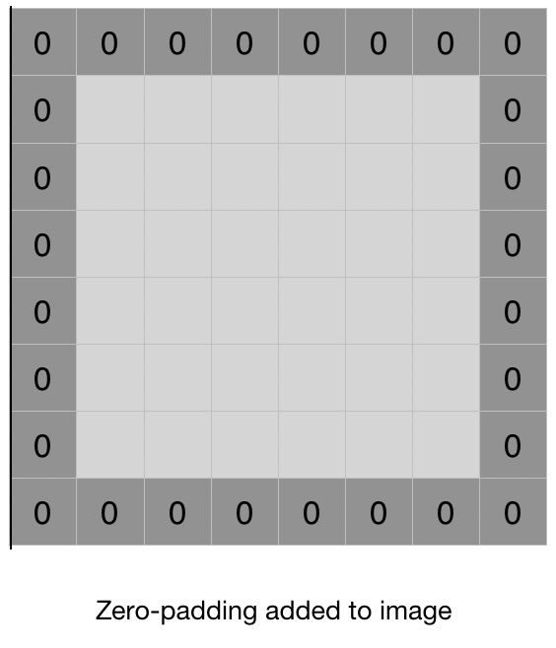
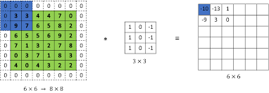

Slide 23
Why Padding?
Padding helps to retain information without losing information
Padding P=(f-1)/2.
In order to work the kernel with processing in the image, padding is added to the outer frame of the image to allow for more space for the filter to cover in the image.
Adding padding to an image processed by a CNN allows for a more accurate analysis of images.
After convolutional operation we get resultant matrix less than the original image. We apply multiple convolutional operation resultant image will be very small at that point it will become useless, so in order to retain the shape or size of the original image we need padding.

Slide 24
We can compute the spatial size of the output volume as a function of the input volume size(W), the receptive field size of the Conv Layer neurons(F), the stride with which they are applied (S), and the amount of zero padding used(P) on the border.
the correct formula for calculating how many neurons “fit” is given by (W-F+1).If padding and stride added it will be (W-F+2P)/S+1.
For example for a 7x7 input and a 3x3 filter with stride 1 and pad 0 we would get a 5x5 output. With stride 2 we would get a 3x3 output.

Slide 25
Importance of Padding
As we will soon see, sometimes it will be convenient to pad the input volume with zeros around the border. The size of this zero-padding is a hyperparameter.
The nice feature of zero padding is that it will allow us to control the spatial size of the output volumes (most commonly as we’ll see soon we will use it to exactly preserve the spatial size of the input volume so the input and output width and height are the same).
Use of zero-padding. consider an example, note that the input dimension was 5 and the output dimension was equal: also 5. This worked out so because our receptive fields were 3 and we used zero padding of 1. If there was no zero-padding used, then the output volume would have had spatial dimension of only 3, because that is how many neurons would have “fit” across the original input. In general, setting zero padding to be P=(F-1)/2 when the stride is S=1 ensures that the input volume and output volume will have the same size spatially.

Slide 26
About filter
There is not specific way to choose such dimensions or sizes of filters.
In general, we would like to use smaller odd-sized kernel filters.
A common choice is to keep the kernel size at 3x3 or 5x5.
2x2 and 4x4 are generally not preferred because odd-sized filters symmetrically divide the previous layer pixels around the output pixel
but it would be computationally inefficient since an even sized filter leads to asymmetry. For eg, when a 3x3 filter is used, there would be a padding of 1 in all sides (if you want the output to be of the same size as input
because of extremely longer training time consumed and expensiveness, we no longer use such large kernel sizes. .

Slide 27
CONVOLUTIONAL OPERATION
The objective of the Convolution Operation is to extract the high-level features such as edges, from the input image.
There are two types of results to the operation — one in which the convolved feature is reduced in dimensionality as compared to the input, and the other in which the dimensionality is either increased or remains the same.

Slide 28
Pooling Layer
Similar to the Convolutional Layer, the Pooling layer is responsible for reducing the spatial size of the Convolved Feature.
This is to decrease the computational power required to process the data through dimensionality reduction.
Furthermore, it is useful for extracting dominant features.
There are two types of Pooling: Max Pooling and Average Pooling.
Max Pooling returns the maximum value from the portion of the image covered by the Kernel.
Average Pooling returns the average of all the values from the portion of the image covered by the Kernel.
Max Pooling performs a lot better than Average Pooling.

Slide 29
Pooling involves selecting a pooling operation, much like a filter to be applied to feature maps.
The size of the pooling operation or filter is smaller than the size of the feature map; specifically, it is almost always 2×2 pixels applied with a stride of 2 pixels.

Slide 30
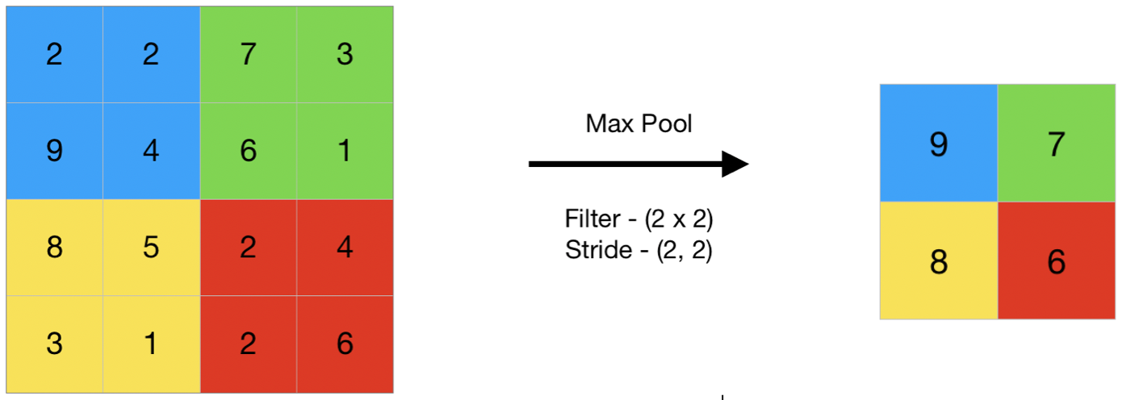
Max Pooling

Slide 31
Why do we use Max Pooling?
Max polling helps in extracting low-level features from the data like edges, points etc. or if we talk about image processing the max-pooling helps to extract the sharpest features on the image and the sharpest features are a best lower-level representation of the image.
Loosely, the low-level feature extraction is based on signal/image processing techniques, while the high-level feature extraction is based on machine learning techniques.

Slide 33
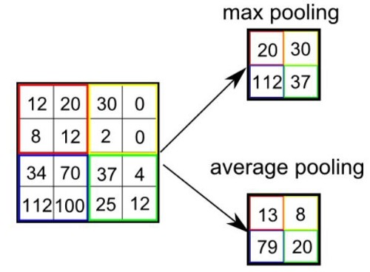

Slide 34
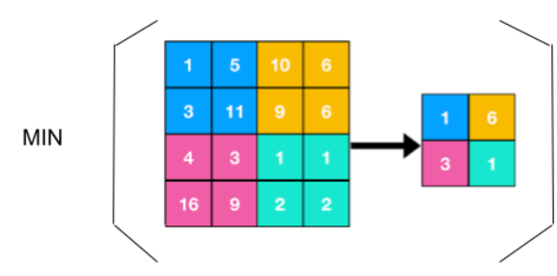
Min Pooling

Slide 35
Min Pooling
In min pooling, the layer operates with the most non-prominent feature of the feature map provided by the convolutional layer.
More basically we can say it selects the minimum valued element from the region captured by the filter in any feature map.
We can choose background color using Min pooling.
As the example image showed above we use the min pooling where we are required to extract the most irrelevant features from the data or if we talk about the image data it helps to extract the features which have lower sharp values or the edgeless features from the image.

Slide 36
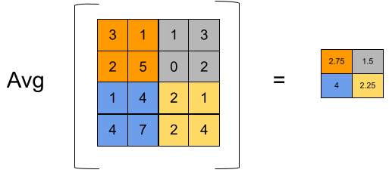
Average pooling

Slide 37
pooling is faster to compute than convolutions.
When we use average pooling it helps to extract the smooth features.
If talking about image data if we apply the average pooling layers we will get them out as the combination of all colors presented in the region covered by the feature map.
So if the distribution of the data points in data and colors in any image is smooth or more basically the distribution is proper then we can use the Average pooling to get proper results.

Slide 38
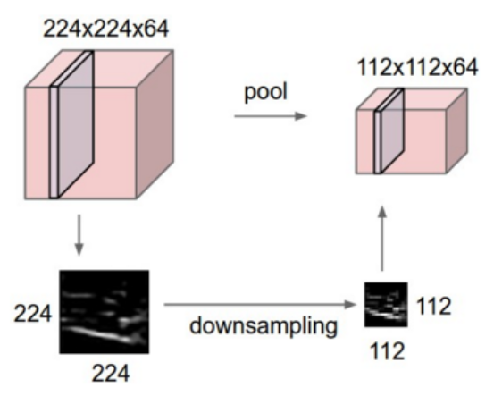

Slide 39
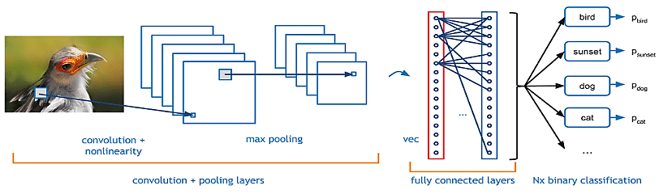

Slide 40
Fully connected Layers
After going through the above process, we have successfully enabled the model to understand the features.
Moving on, we are going to flatten the final output and feed it to a regular Neural Network for classification purposes.
Now that we have converted our input image into a suitable form for our Multi-Level Perceptron, we shall flatten the image into a column vector.
The flattened output is fed to a feed-forward neural network and backpropagation applied to every iteration of training.
Over a series of epochs, the model is able to distinguish between dominating and certain low-level features in images and classify them using the Softmax Classification technique.

Slide 42
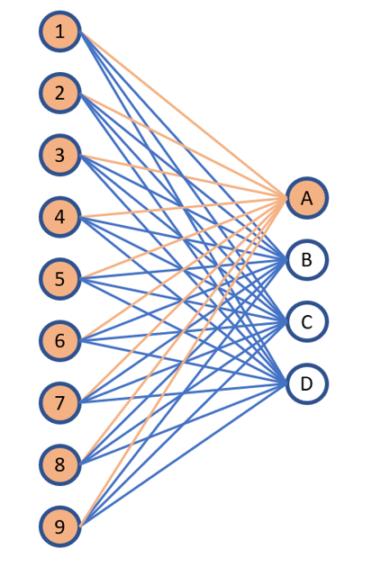
Fully connected Layers

Slide 43
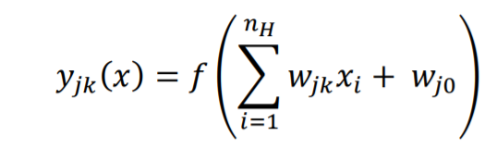
Fully connected Layers
In fully connected layers, the neuron applies a linear transformation to the input vector through a weights matrix.
A non-linear transformation is then applied to the product through a non-linear activation function f.

Slide 44
Neurons in a fully connected layer have full connections to all activations in the previous layer, as seen in regular Neural Networks.

